Slide 1
A review on instance-level 6D object pose estimation
Author: Tao Zhou
Supervisor: Prof. Dr.-Ing. habil. Alois Christian Knoll
Advisor: Dr. Yinyu Nie
München, 16. März 2023

Slide 2

A review on instance-level 6D object pose estimation
Referent
Technische Universität München
TUM School of Computation, Information and Technology
Lehrstuhl für Robotik, Künstliche Intelligenz und Echtzeitsysteme
München, 16. März 2023

Slide 3
Contents
Introduction
Challenges
Traditional Methods
Deep learning-based Methods
The RGB Image-based Deep Learning Method
The RGB-D Image-based Deep Learning Method
Experiments
Future research directions

Slide 4
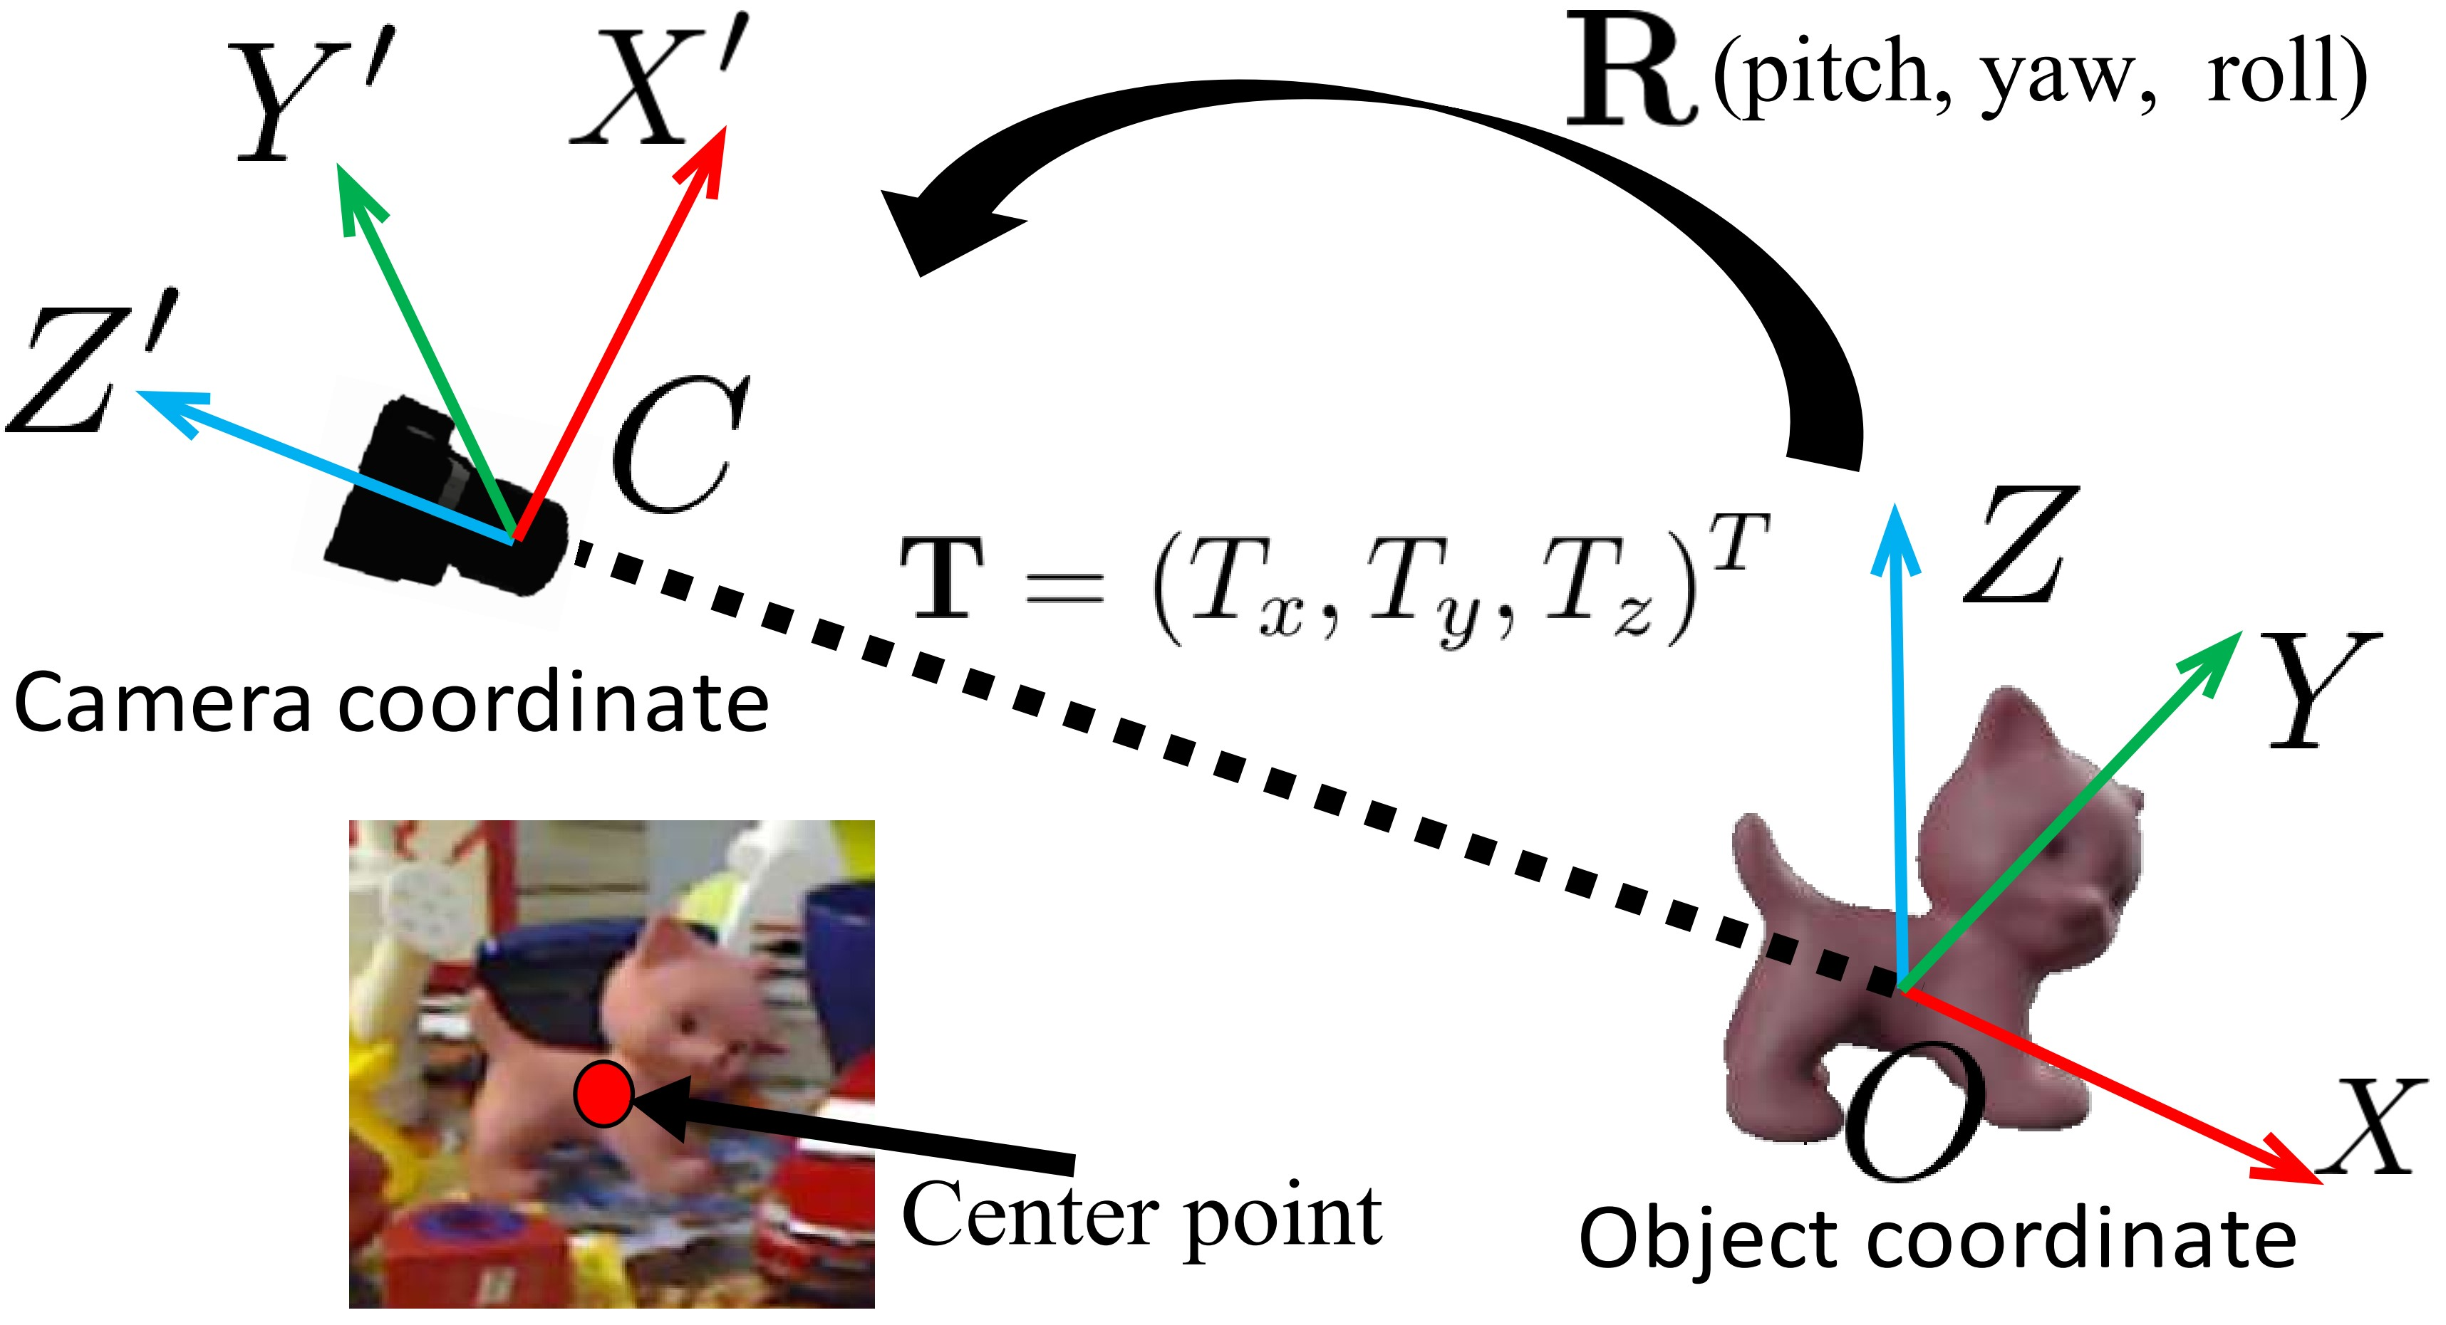
1. Introduction
Notes:
6D object pose estimation has been playing a significant role in computer vision and
robotics in recent years, which focuses on determining the estimation of 3D translation
T (Tx, Ty, Tz ) and 3D rotation R (pitch, yaw, and roll) of rigid objects from the object’s
coordinate system to the camera’s coordinate system, as illustrated in Figure 1.1.

Slide 5
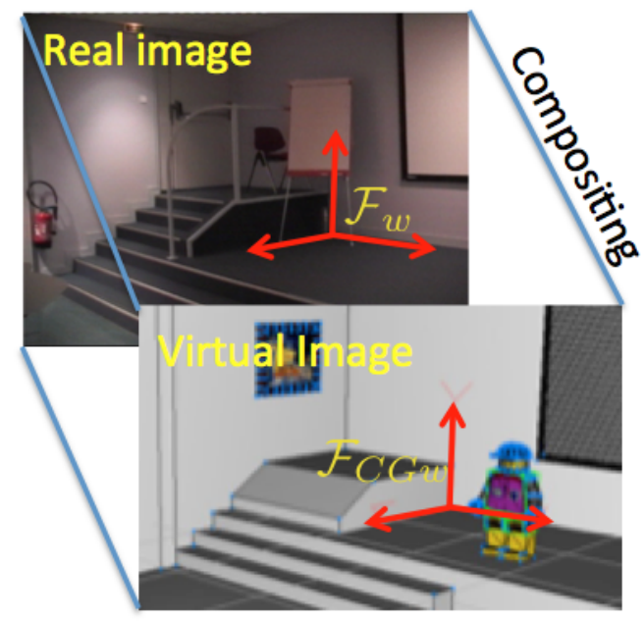
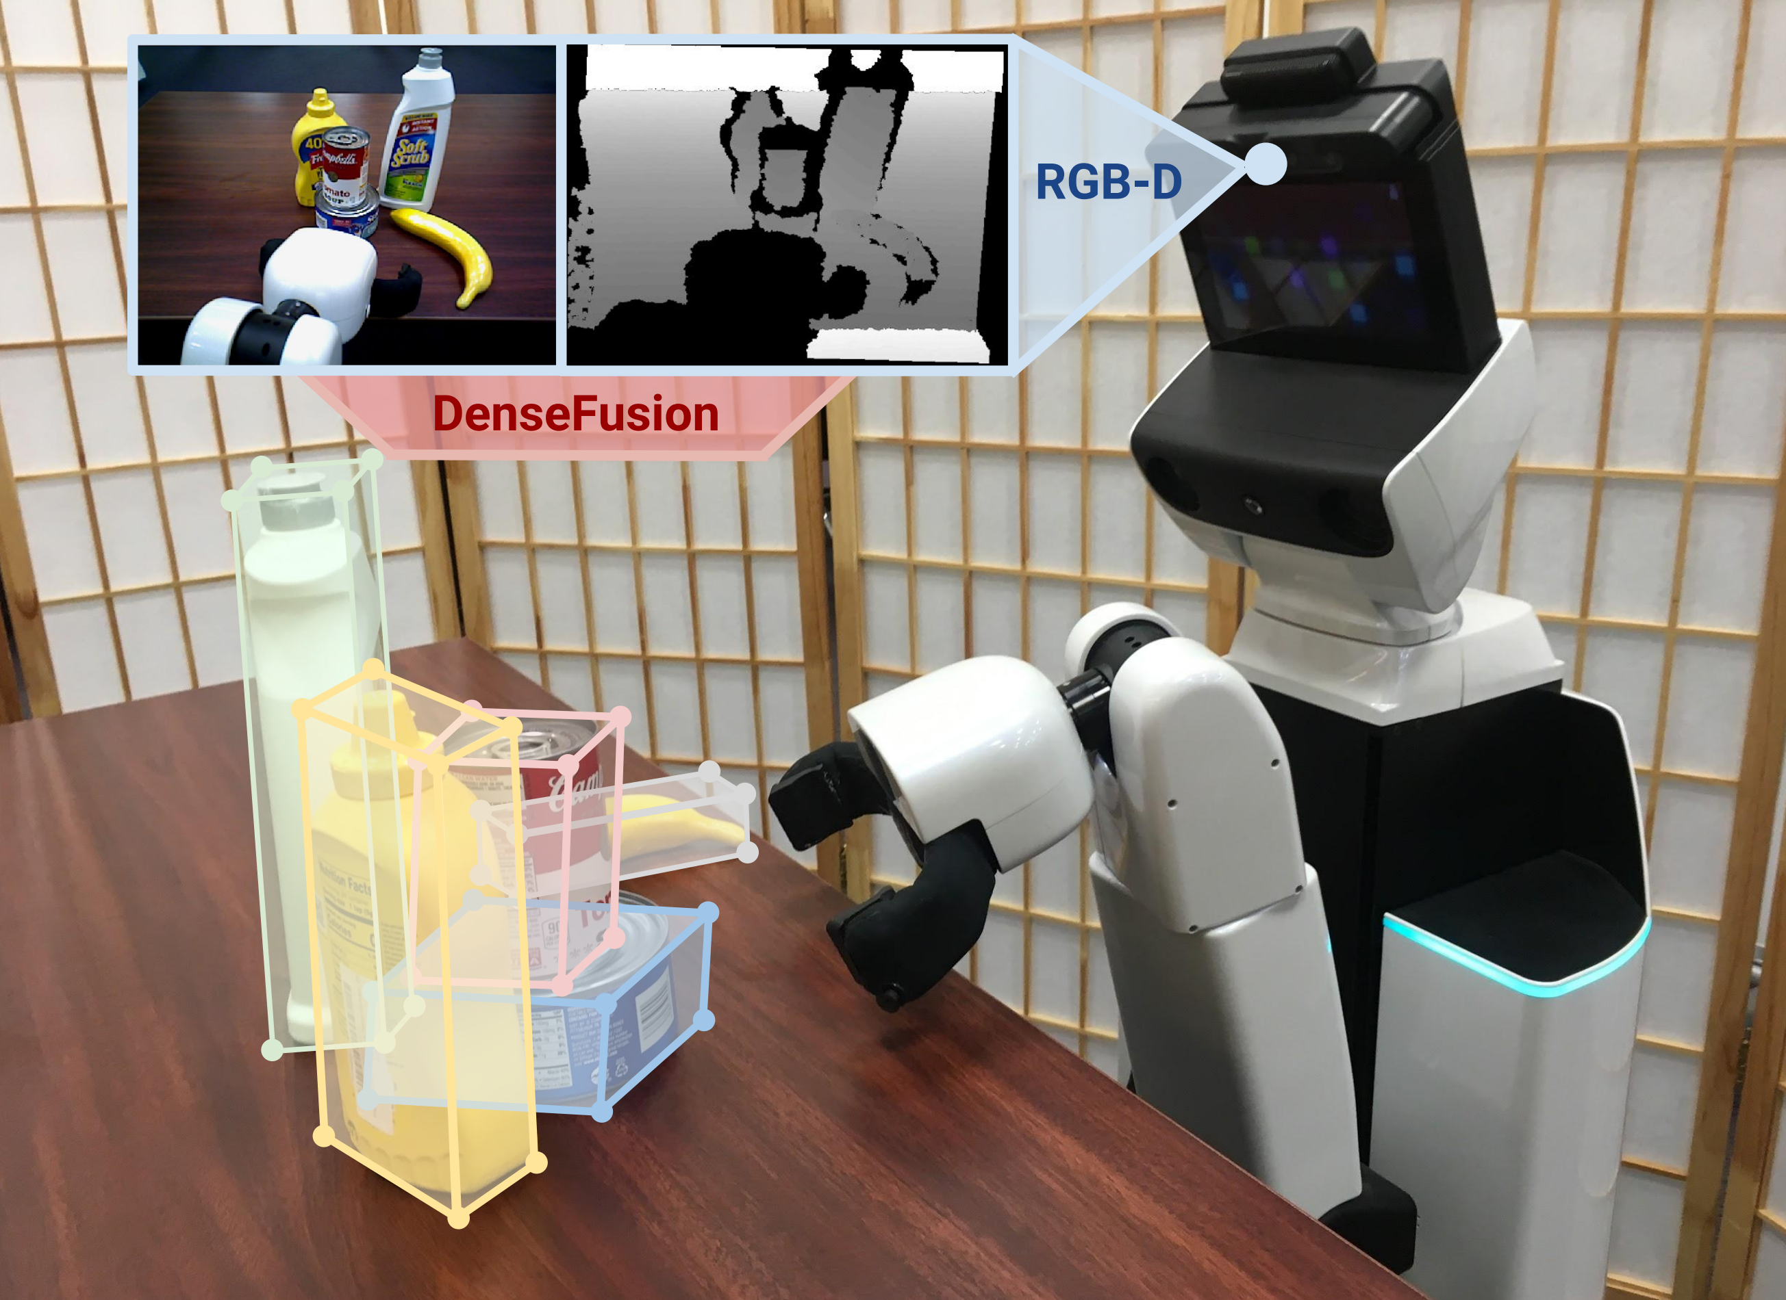
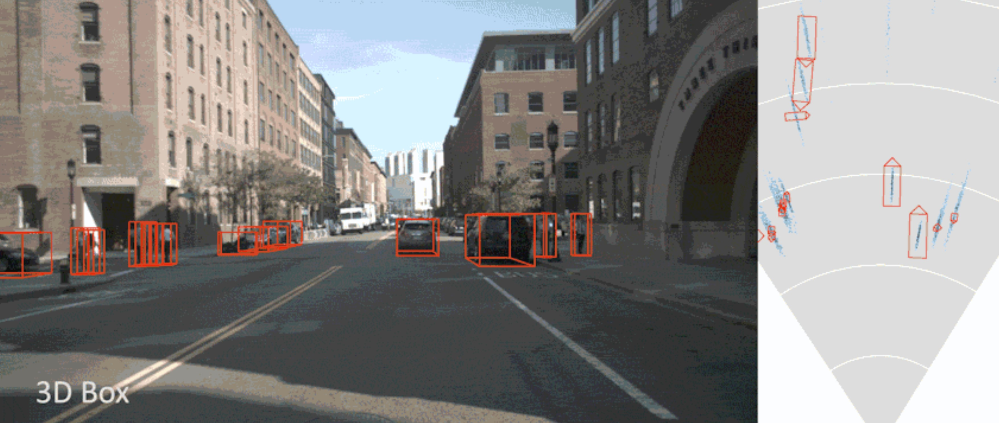
Applications
Augmented reality
Robotic grasping and manipulation
Autonomous driving
Notes:
Robotics: increase the accuracy and simplicity of the grasp pose in robotics manipulation
Autonomous driving: effificiently understand its surrounding and make informed decisions about how to avoid collisions
AR: tackle a motion tracking task and enable the AR to provide a more immersive and realistic experience for users

Slide 6
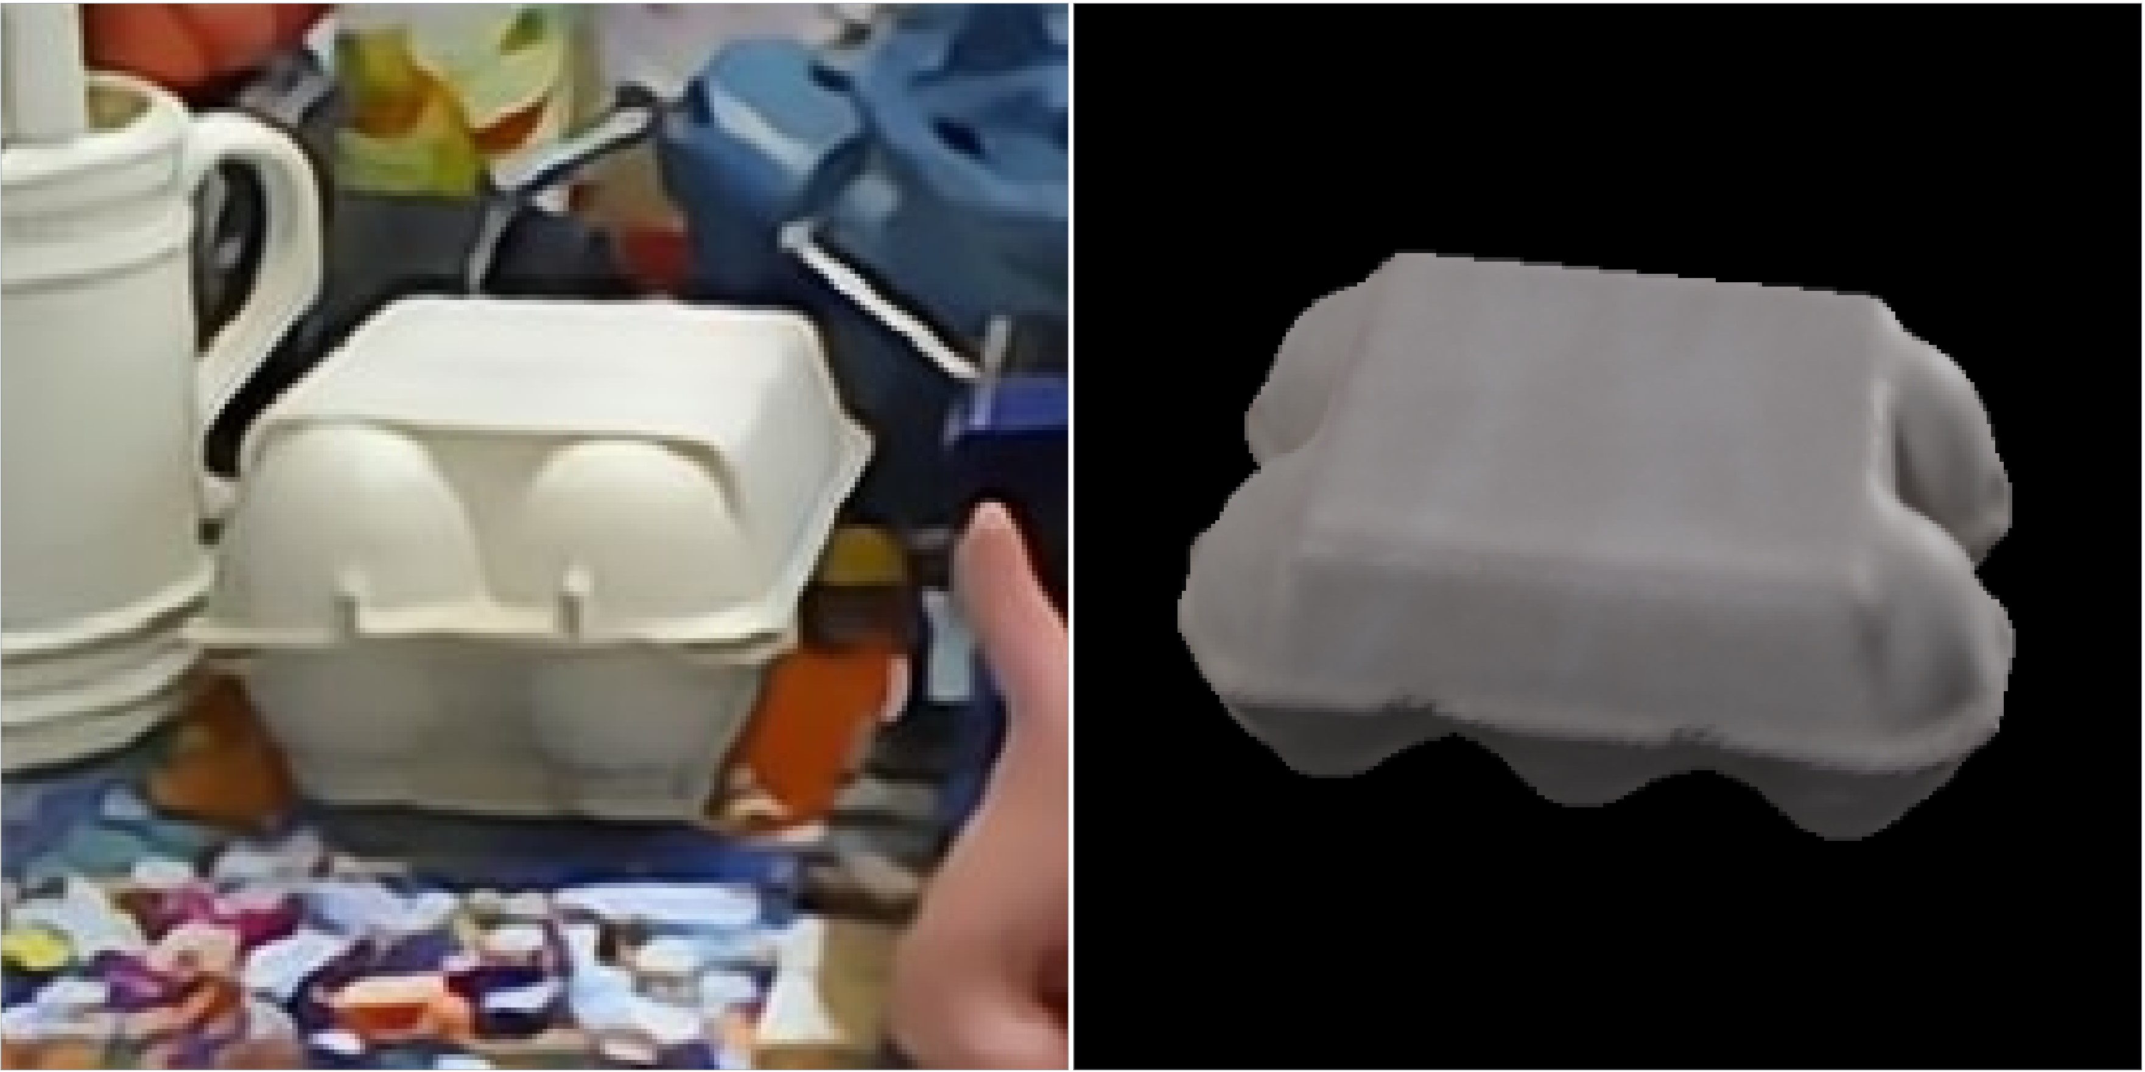
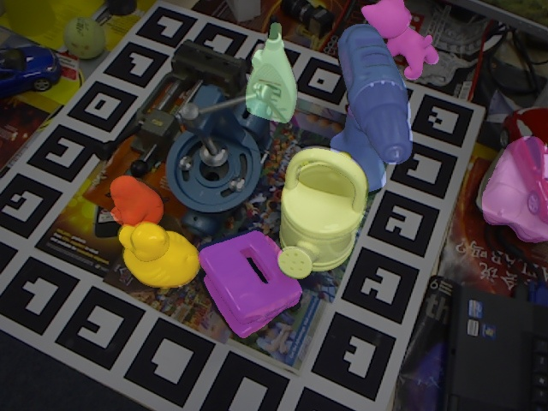
2. Challenges
Clutter
Occlusion
Viewpoint variation
Illumination variation
Real-time constraints
Symmetric object (eggbox)
Occlusion scenarios

Slide 7
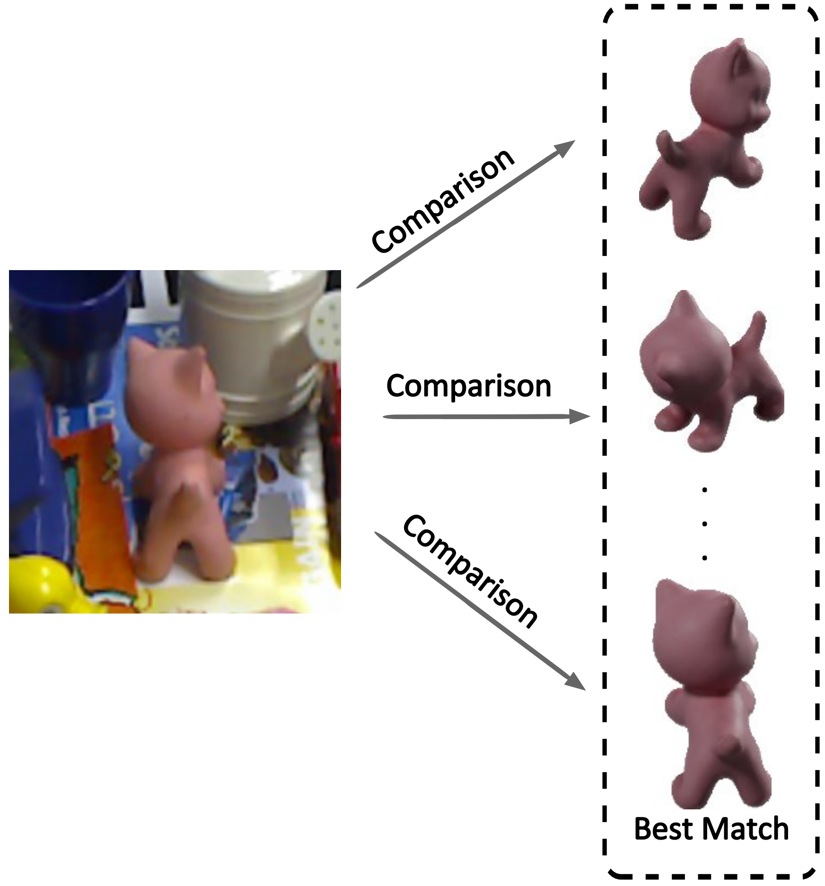
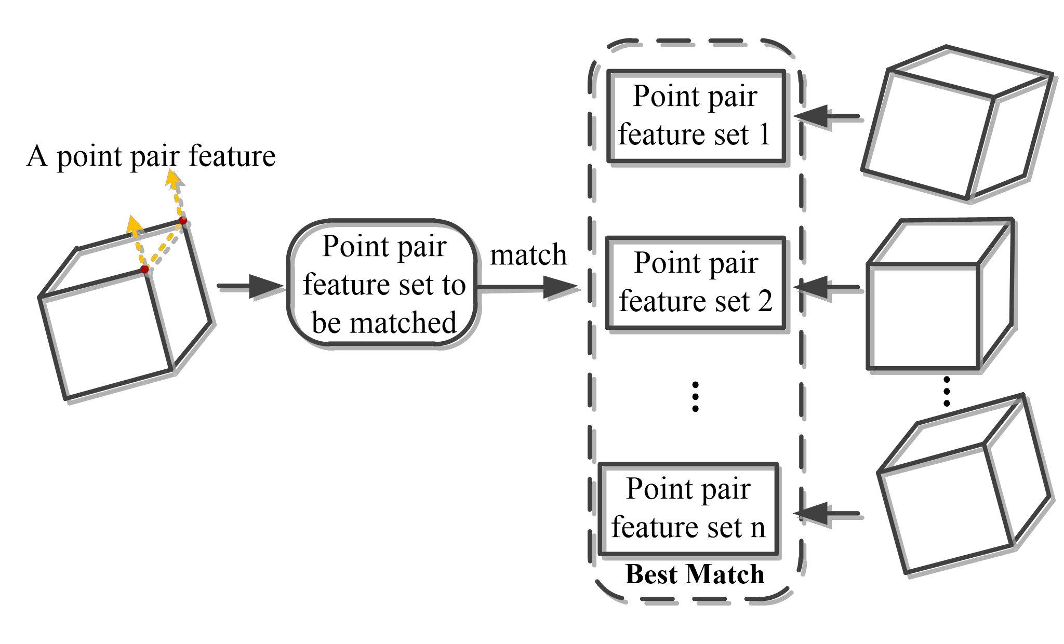
3. Traditional Methods
The template-based method
The point-based method
Notes:
The template-based method uses a pre-defifined template of the object to estimate its pose in an image by aligning the template with the detected features in the image,
is sensitive to illumination variations, which can make it diffificult to accurately align the template with the image.
The point-based method estimates the 6D object pose by identifying feature points on a point cloud, matching them to corresponding points on a pre-defifined global model,
and aligning the resulting point pairs,
be sensitive to the initial alignment of the point pairs, which can impact the accuracy of the pose estimation.

Slide 8
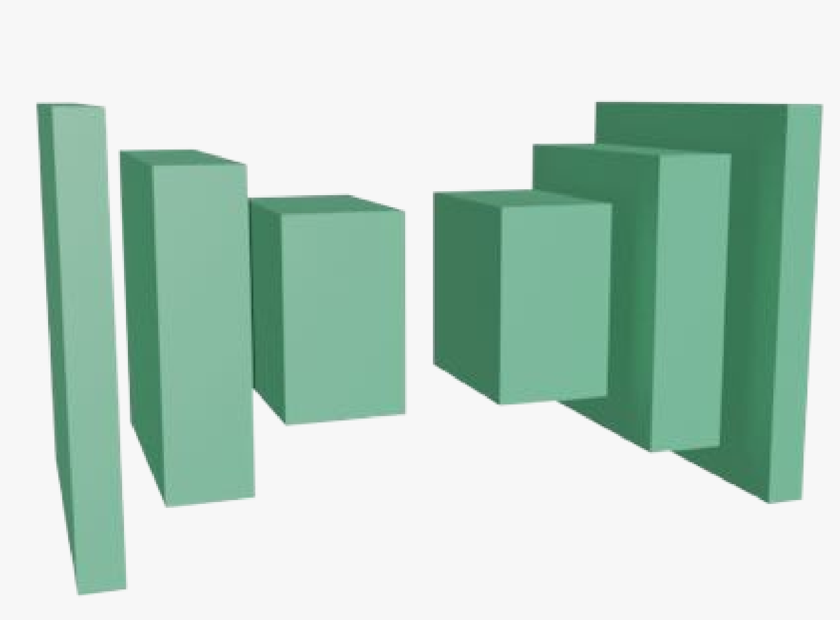

4. Deep learning-based Methods
CNN
RNN

Slide 9
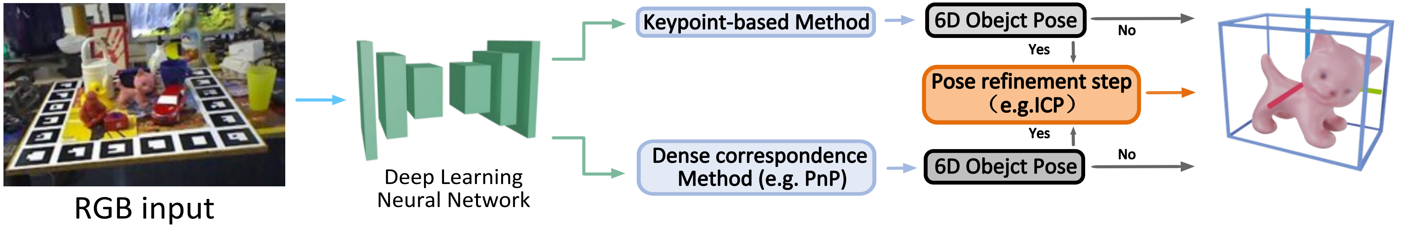
4.1 The RGB Image-based Deep Learning Method
Overview of RGB image-based deep learning methods

Slide 10
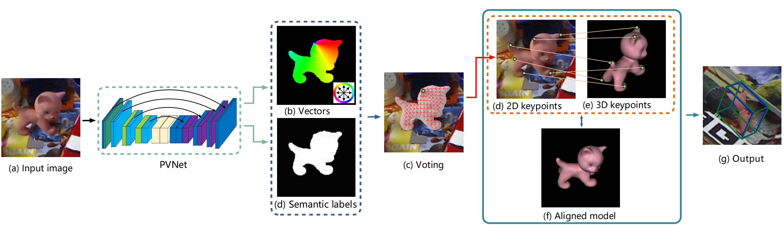
- Keypoint-based Method
Pixel-wise Voting Network (PVNet)
Notes:
used to localize 2D key points through RANSAC-based voting. the PnP-algorithm is applied to obtain the 6D pose estimation
occlusion and the design of network architectures. the RANSAC algorithm [21] is time-consuming due to its iterative process.

Slide 11
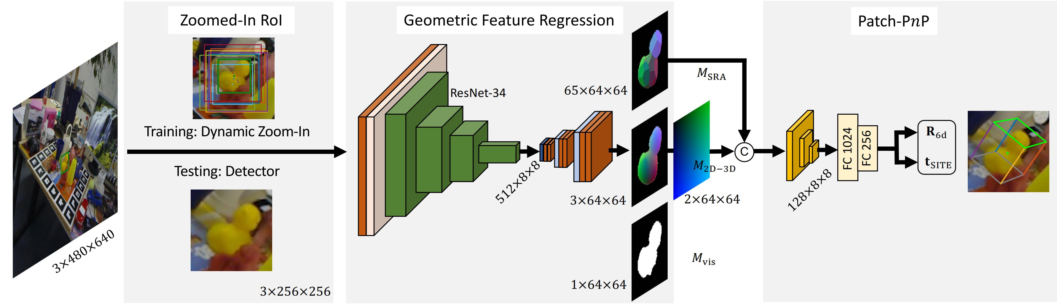
-Dense correspondence method - PnP
Geometry-Guided Direct Regression Network (GDR-Net)
Notes:
It find the correspondence between image pixels and mesh vertexes and recover poses within Perspective-n-Point (PnP) manners. And it's used to the non-linearity of rotation space.

Slide 12
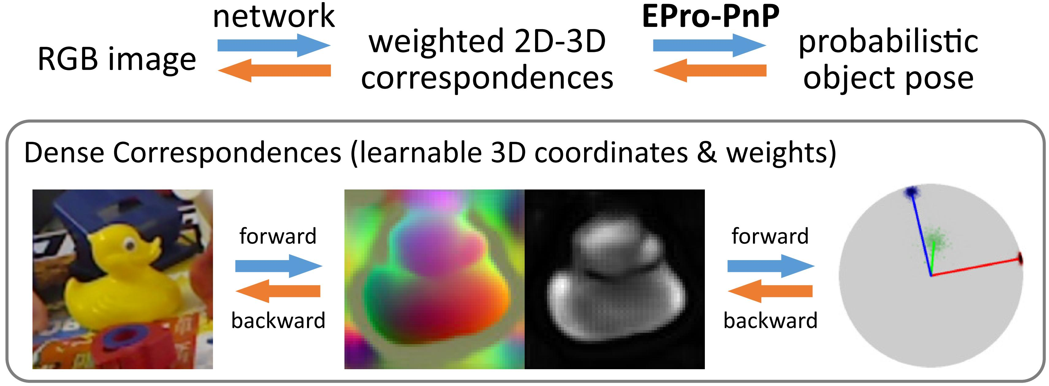
-Dense correspondence method - PnP
End-to-End Probabilistic Perspective-n-Points (EPro-PnP)

Slide 13
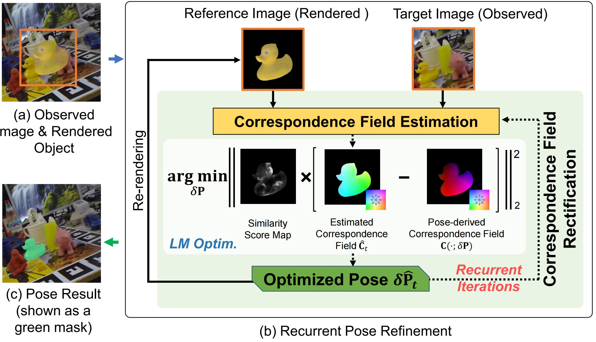
- Keypoint-based Method + Pose Refinement
Recurrent 6-DoF Object Pose Refinement
Notes:
RNNPose was integrated into PVNet [20] framework. The reference image is rendered using the object’s CAD model and an initial pose estimate, which are as inputs. And these inputs are used to generate an optimized object pose which is then used in the next-iteration estimations. After several recurrent iterations, this framework returns a refine object

Slide 14
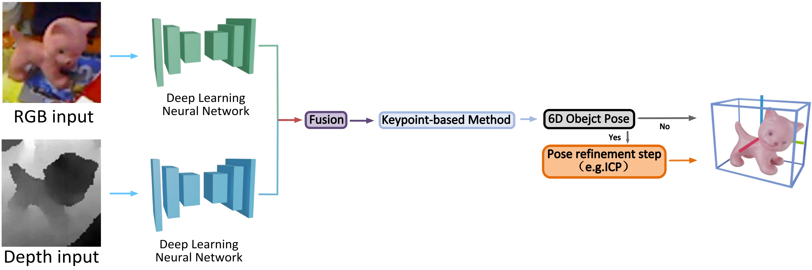
4.2 The RGB-D Image-based Deep Learning Method
Overview of RGB-D image-based deep learning methods

Slide 15
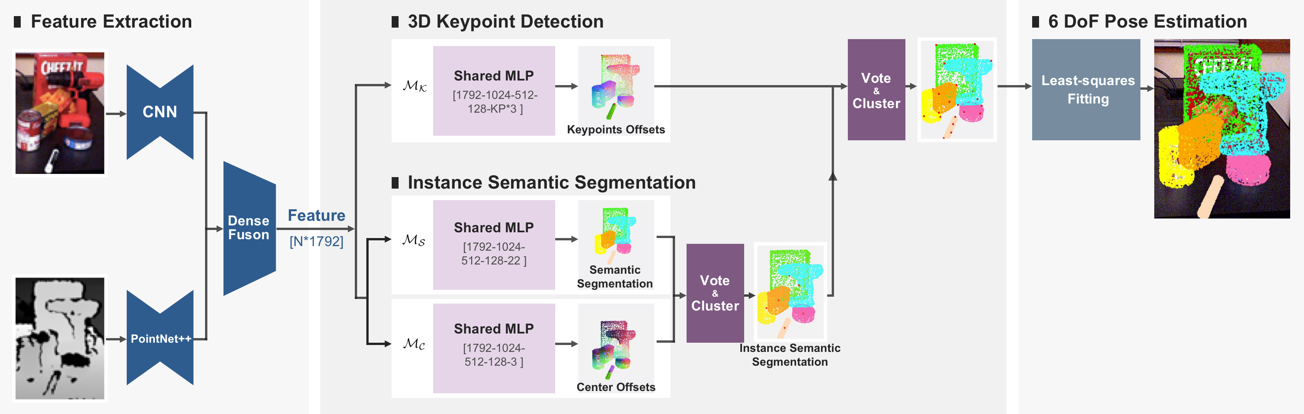
- Keypoint-based Method
PVN3D: A Deep Point-wise 3D Keypoints Voting Network for 6DoF Pose Estimation
Notes:
appearance information and geometry information. It can detect and select the 3D keypoints of the target object using these features and Hough voting. on the accuracy of the detected 3D keypoints.

Slide 16
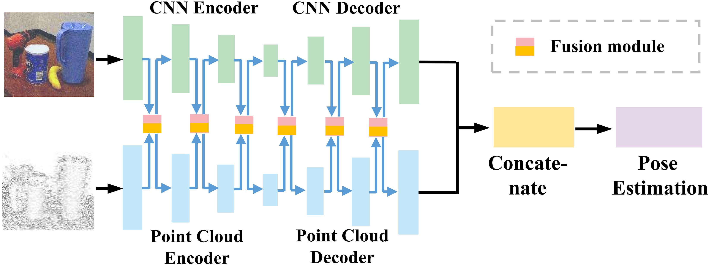
- Keypoint-based Method
FFB6D: A Full Flow Bidirectional Fusion Network for 6D Pose Estimation
Notes:
The fusion is performed on each encoding and decoding layer in order to bridge the
information gap and make the information complementary

Slide 17
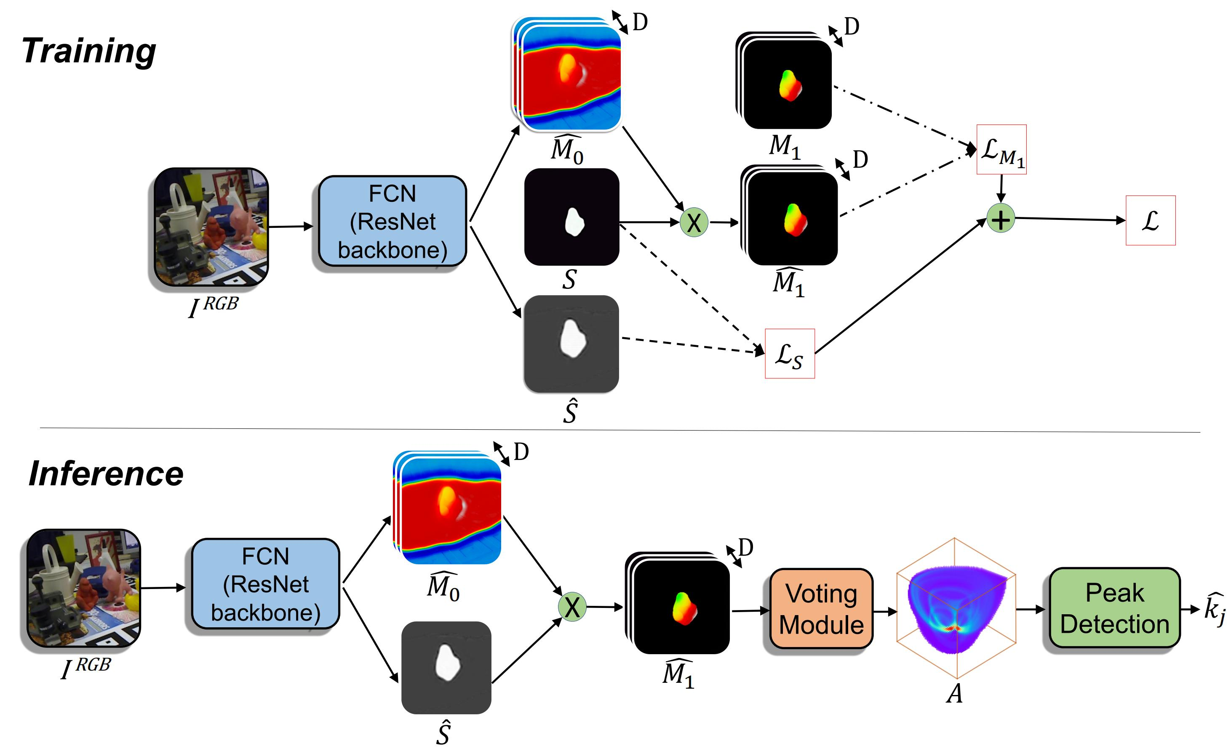
- Keypoint-based Method ( Pose Refinement)
Vote from the Center: 6 DoF Pose Estimation in RGB-D Images by Radial Keypoint Voting
(RCVPose)
Notes:
In the training phase, RCVPose uses a CNN to predict the distance, a 1D quantity, between the 3D point corresponding to the depth of each RGB pixel and a set of dispersed keypoints in the object frame. During inference, the method generates a sphere centered at each 3D point and estimates the distance, which is equal to the radius of the sphere. ICP

Slide 18
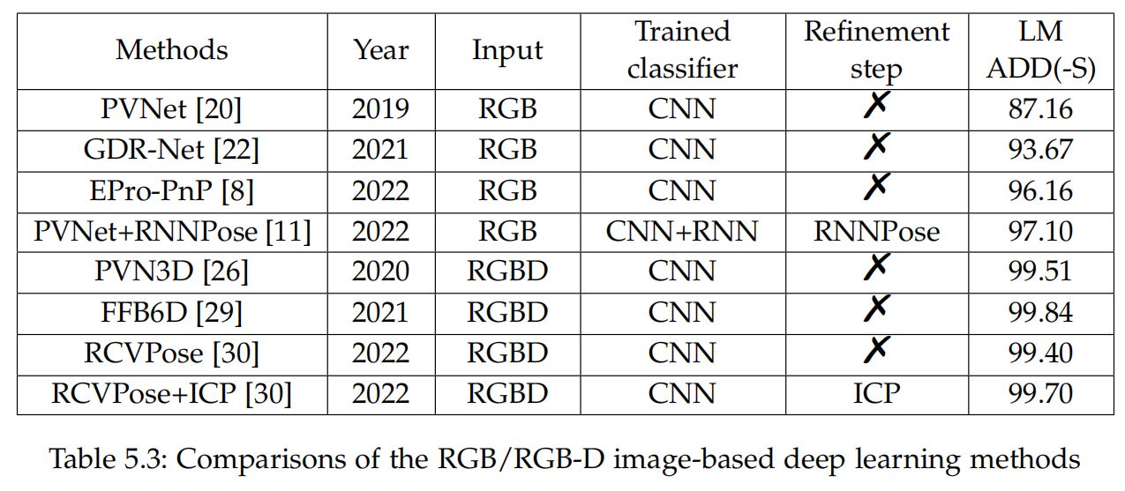
5. Experiments
LineMod datasts
ADD(-S)

Slide 19
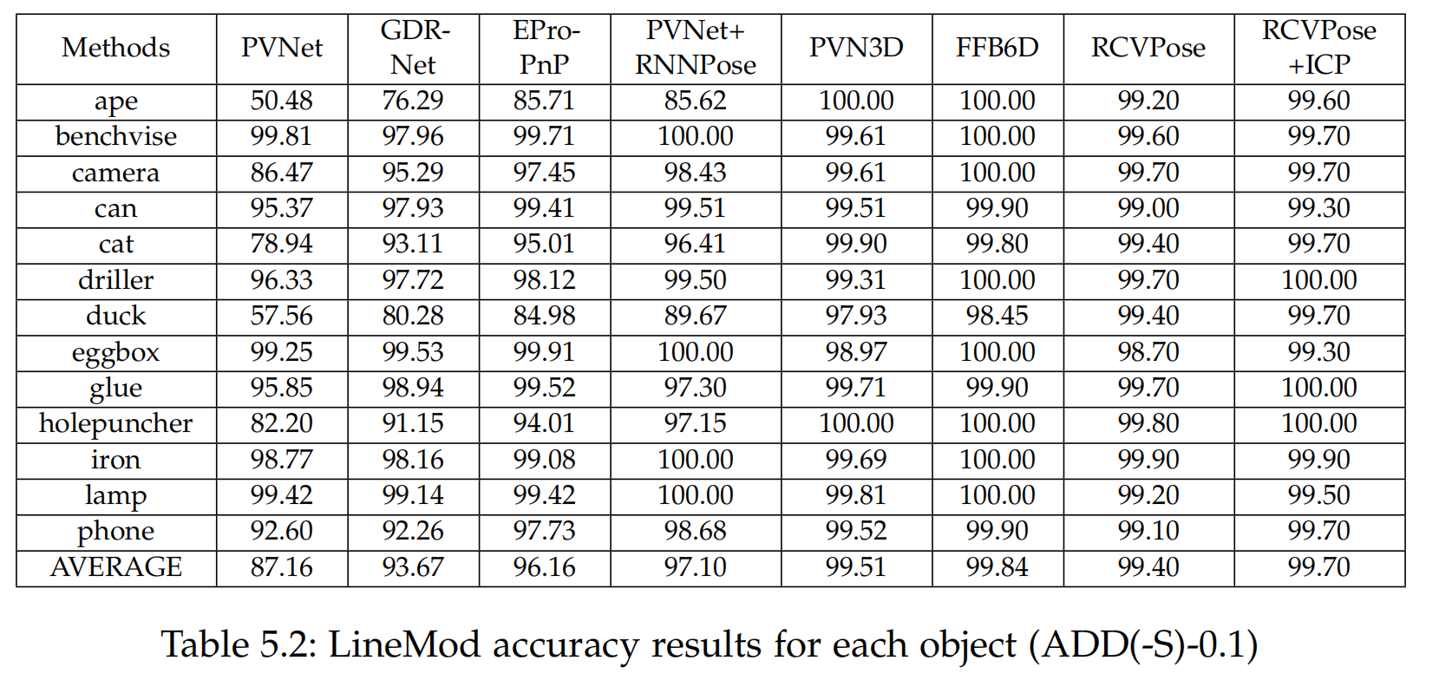
5. Experiments

Slide 20
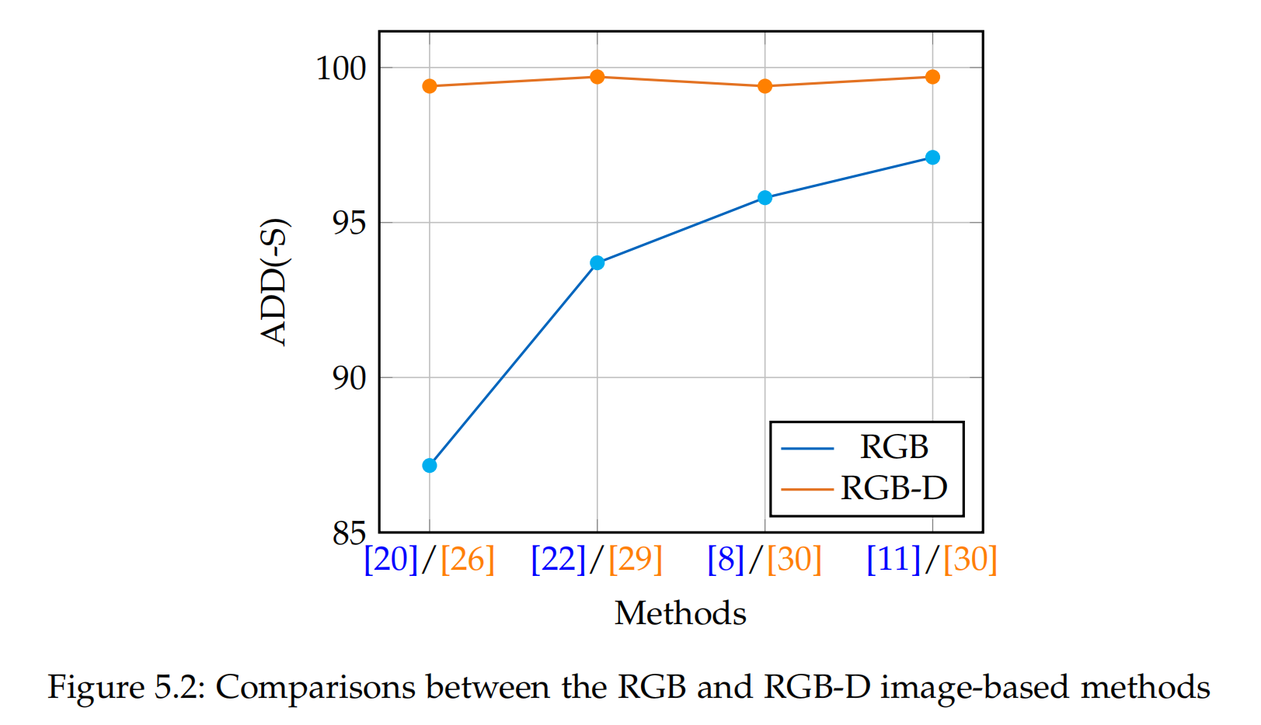
5. Experiments

Slide 21
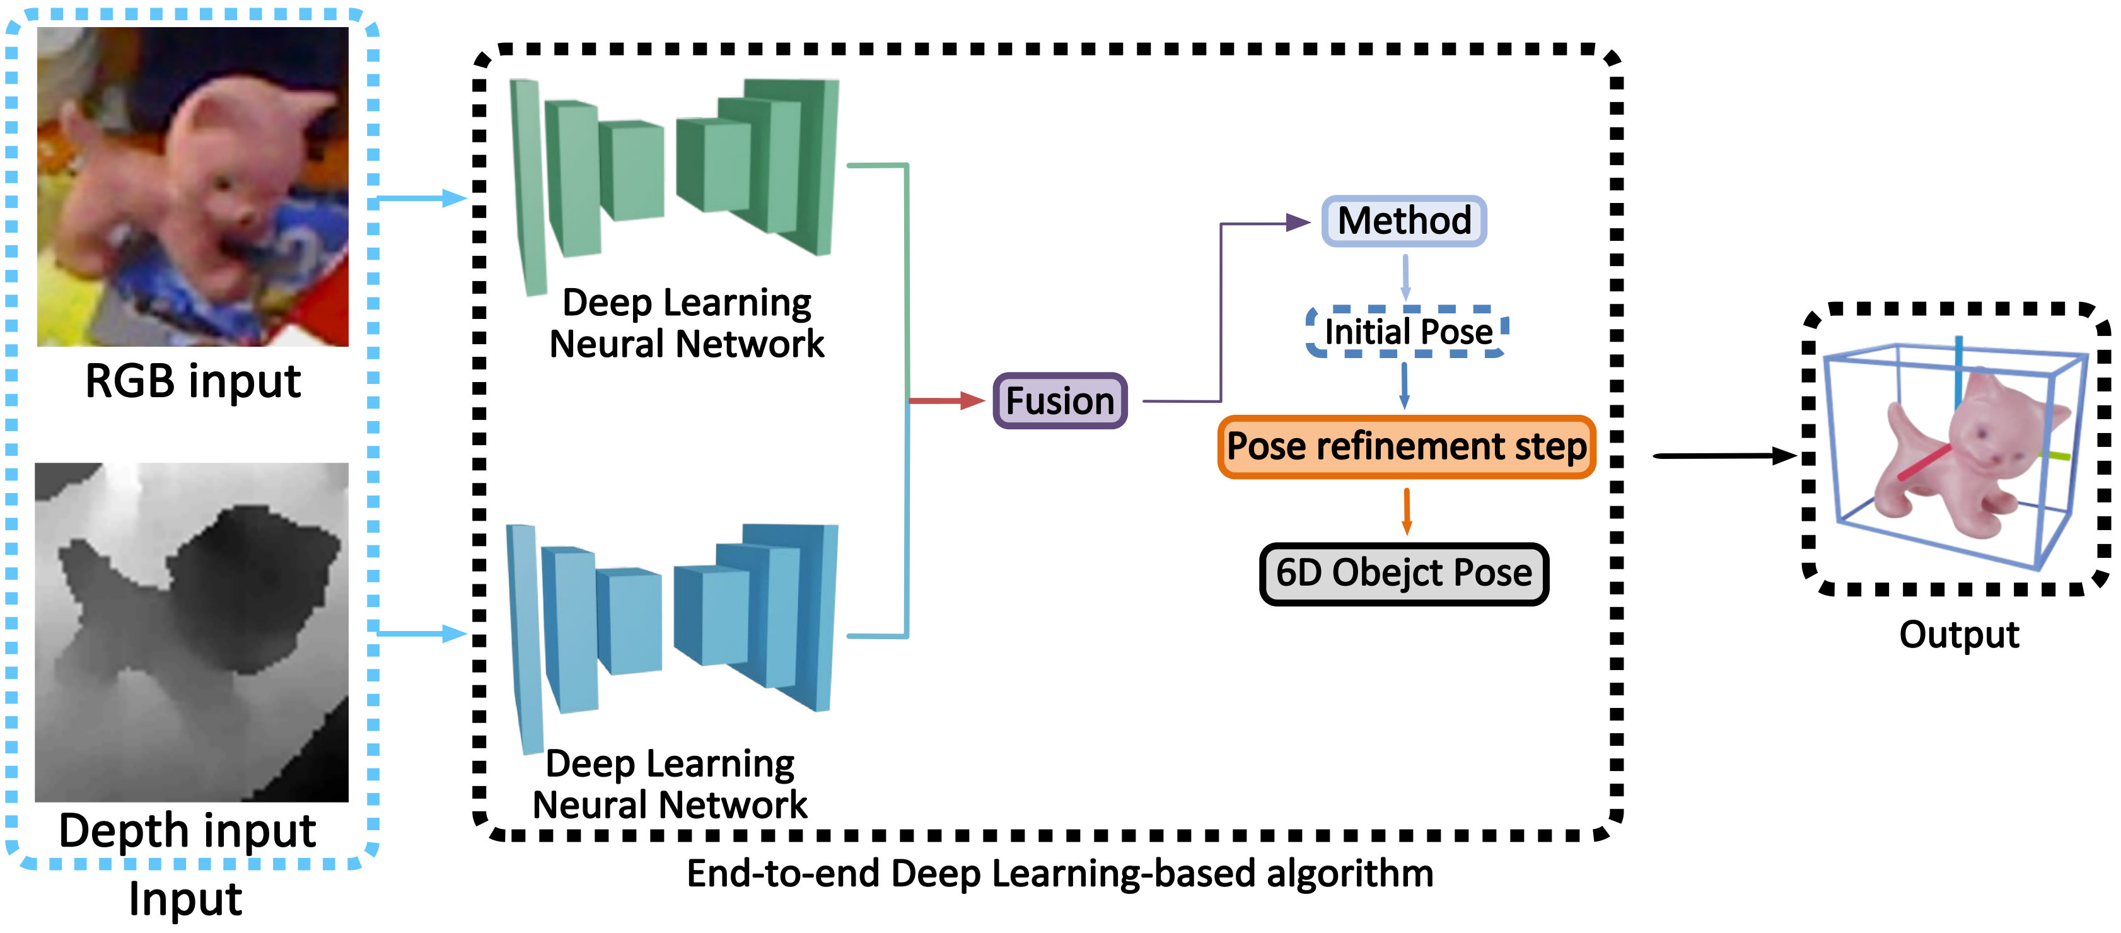
6. Future research directions
End-to-end Deep Learning-based Method with Refinement
Notes:
appearance information and geometry information.

